Slide 1

Using the ABP FRAMEWORK as an Opinionated .NET Application Architecture
Halil İbrahim Kalkan

Slide 2

Agenda
What is the ABP Framework?
Why to use the ABP Framework?
Live coding with the ABP Framework
ABP Framework: feature highlights
Demo: ABP Studio
The ABP Platform
QA

Slide 3
What is the ABP Framework?
ABP Framework offers an opinionated architecture to build enterprise software solutions with best practices on top of the .NET and the ASP.NET Core platforms.
Provides the fundamental infrastructure, production-ready startup templates, modules, UI themes, tooling, guides and documentation to implement that architecture properly and automate the details and repetitive works as much as possible.

Slide 4



ABP: Filling the gap!
Your Application
Focus on your own business code!
ABP Platform
Architecture & Infrastructure for Real-World Business Applications
.NET Platform / ASP.NET Core
Web Application & HTTP Service Development Framework

Slide 5
ABP: The Architecture
Domain Driven Design
& Layered Solution
Modular
Multi-Tenancy (SaaS infrastructure)
Microservice ready

Slide 6
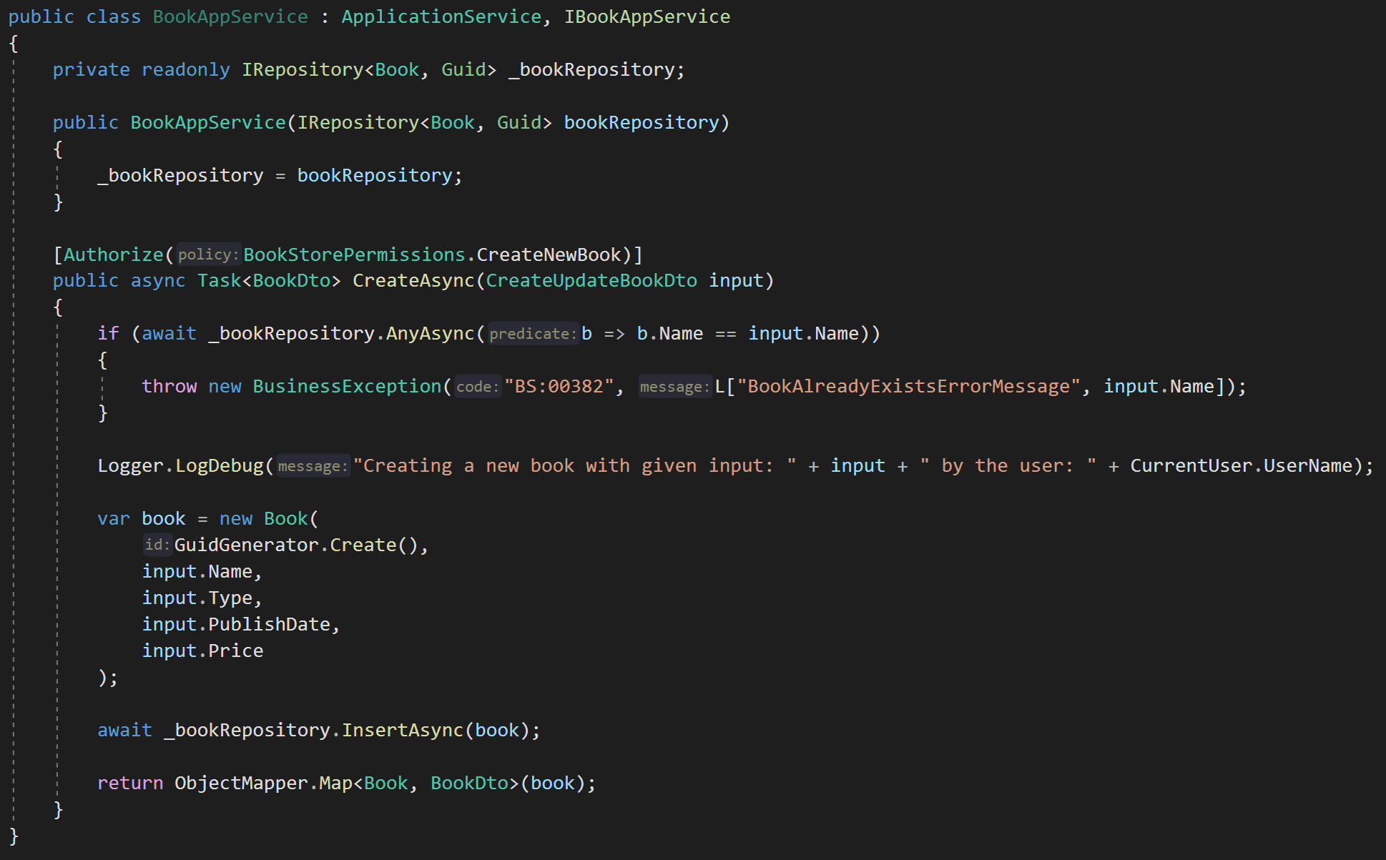
ABP: Infrastructure / Don’t Repeat Yourself!
DDD Base Classes
DI Auto-Register
Generic Repositories
Authorization / Permissions
Auto Validation
Unit Of Work (Transaction Management)
Auto Audit Logging
Localization
Exception Management & Handling
ICurrentUser
ISettingProvider
IFeatureChecker
IGuidGenerator …
Object2Object Map

Slide 7
Why ABP?
Content

Slide 8
Topic title
Content

Slide 9
Topic title
Content

Slide 10
Topic title
Content

Slide 11
Topic title
Content

Slide 12
Topic title
Content

Slide 13
Topic title
Content

Slide 14
Topic title
Content

Slide 15
Topic title
Content

Slide 16
Topic title
Content

Slide 17



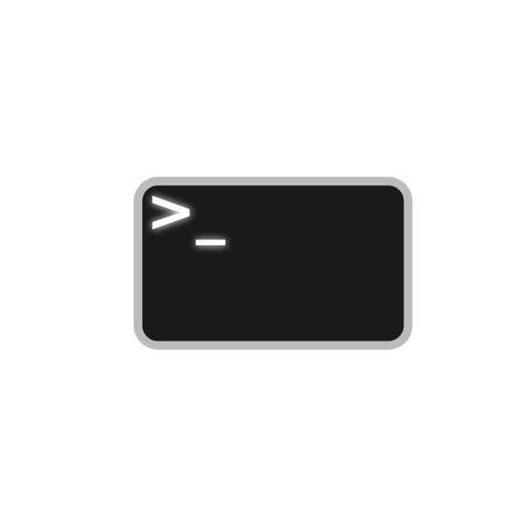














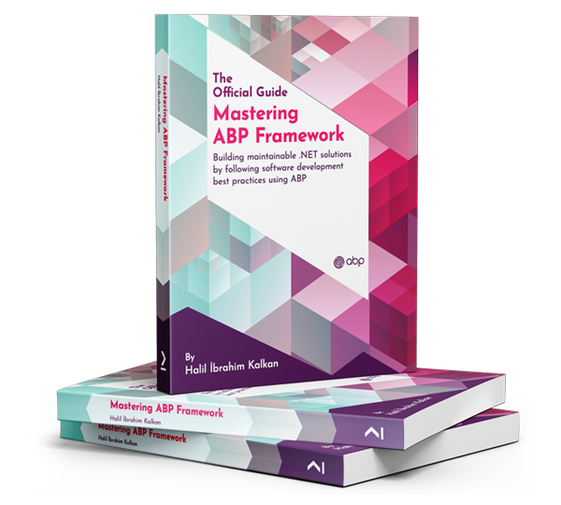



The ABP Platform
Startup Templates
More Startup Templates
Framework Packages
CLI
Pro Themes
Basic Themes
Framework
Commercial
Pro Modules
Basic Modules
Examples
Docs & Books
Community
Events
eShopOnAbp
Discord
Articles
Video Tutorials
Blog

